Slide 1
“Intelligent Vehicle Safety and Tracking System with Automatic Accident Detection and Messaging”
Knowledge Institute Of Technology
Sivasankar.C IIi EEE
Thirumalai v iii eee

Slide 2
Objective
To ensure safety of the people and to save their lives
To give comfort to the people
To make people life easier
To immediately respond in emergency situations

Slide 3
TECHNOLOGIES USED
Internet Of Things[IOT]
Google Cloud
MIT App Inventor

Slide 4
Hardwares Used
NodeMCU
MPU6050 [Gyroscopic Sensor]
Ublox Neo 6m GPS Module
Breadboard
16*2 LCD display
Potentiometer
Buzzer

Slide 5
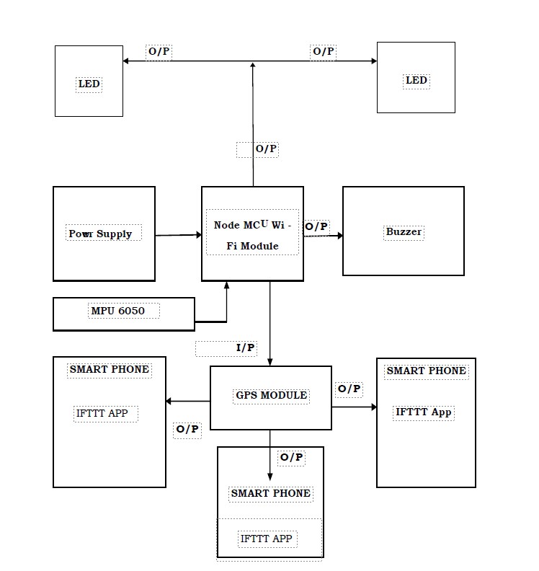
BLOCK DIAGRAM

Slide 6
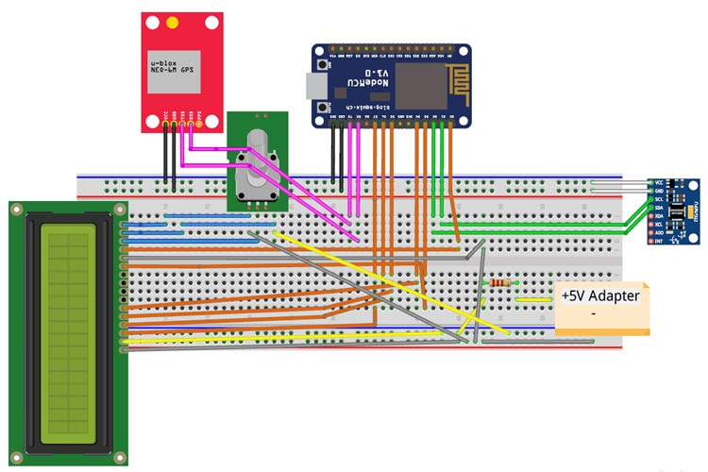
CIRCUIT DIAGRAM

Slide 7
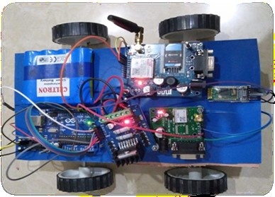
prototype

Slide 8
WORKING
The mpu 6050 sensor detects acceleration and position of the vehicle
In case of rash driving if the vehicle exceeds a limit or an accident occur it will send data to node Mcu.
The data is collected and sent with exact map coordinates which can be viewed by our developed app
It also send an alert mail and a call to emergency services and our families

Slide 9
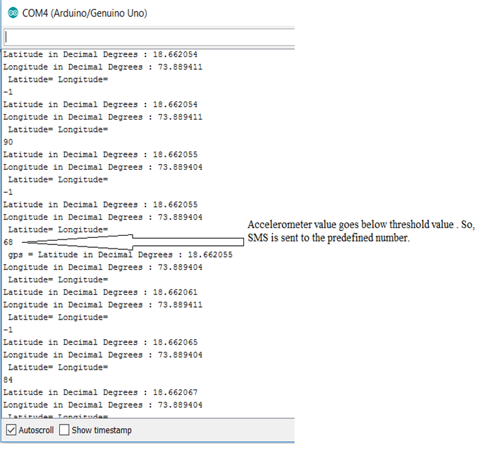
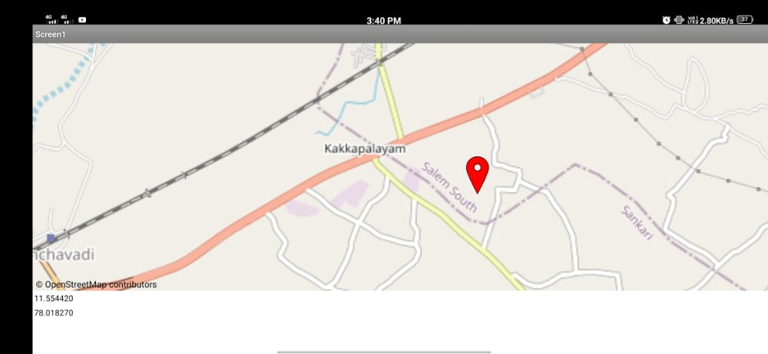
RESULT

Slide 10
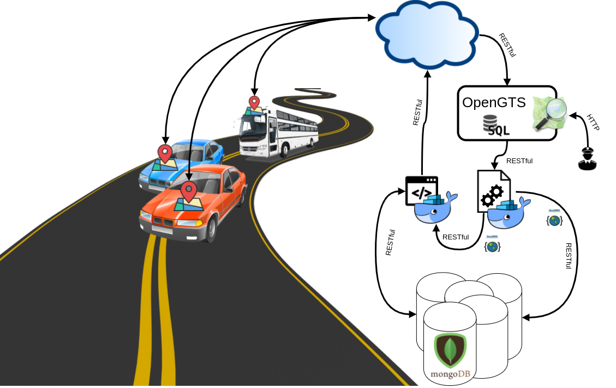
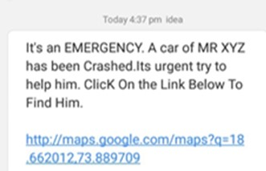
WORKING METHODOLOGY
MESSAGE INTERFACE

Slide 11
advantages
This method is simple , reliable .
It is merely accurate
Useful in emergency situations
Cost effective
Saves time , money and life of the people

Slide 12
Applications
Automotive and transport vehicles.
Buses.
Automotive and transport vehicles.
Security, remote monitoring and transportation and logistics.

Slide 13
THANK YOU…

